Slide 1
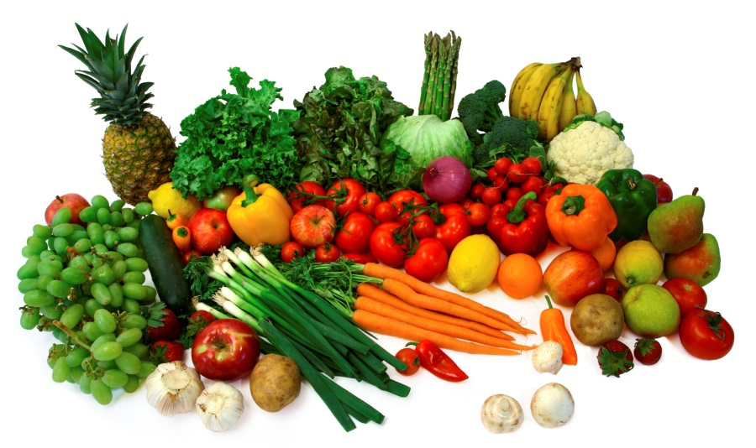
Managing Stress: What can diet do for you?
By Claudia Martin-Ayoade, MBA, MS, RDN, LD
Registered Dietitian
Johnson County Community College Dining Services

Slide 2
Learning Objectives
Understanding and defining stress.
Identify sources of stress.
An awareness of the role nutrition plays in the body’s response to Stress.
Specific knowledge about: exercise and nutritional prescription to treat and control the effects of stress.

Slide 3
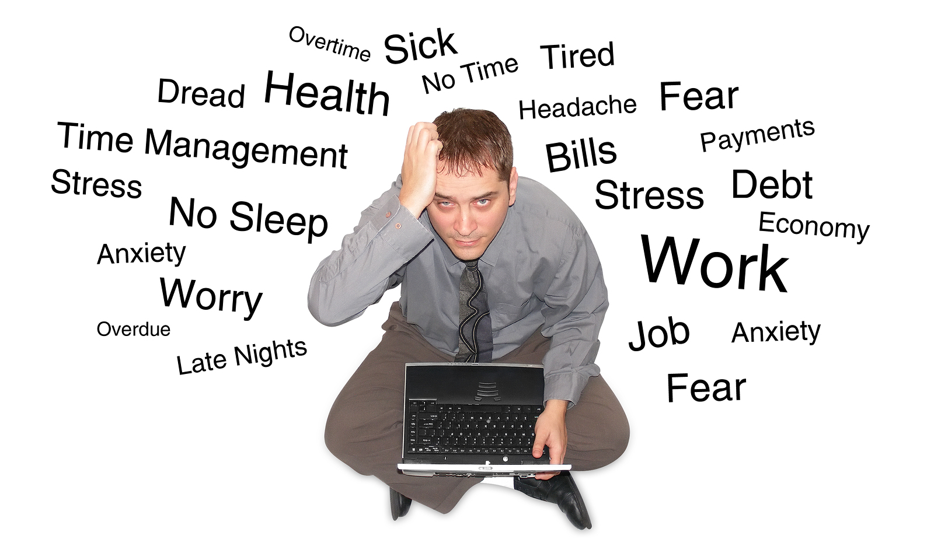
What is Stress?
Stress is a fact of nature in which forces from the inside or outside world affect the individual.
The individual responds to stress in ways that affect the individual, as well as their environment.

Slide 4
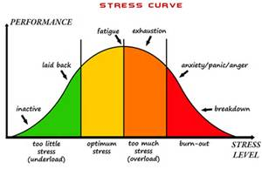
What is Stress? 2
Given the overwhelming amount of stress that we encounter in our modern lives, stress is usually thought of as a negative experience.
However, biologically, stress can be a neutral, negative, or positive experience.
Chronic Stress can cause serious health risks.

Slide 5
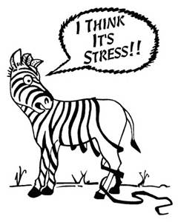
The Body’s Response to Stress
The Stress Response
In response to stress, or even perceived stress, the body mobilizes an extensive array of physiological and behavioral changes in a process of continual adaptation, with the goal of maintaining homeostasis and coping with the stress.

Slide 6
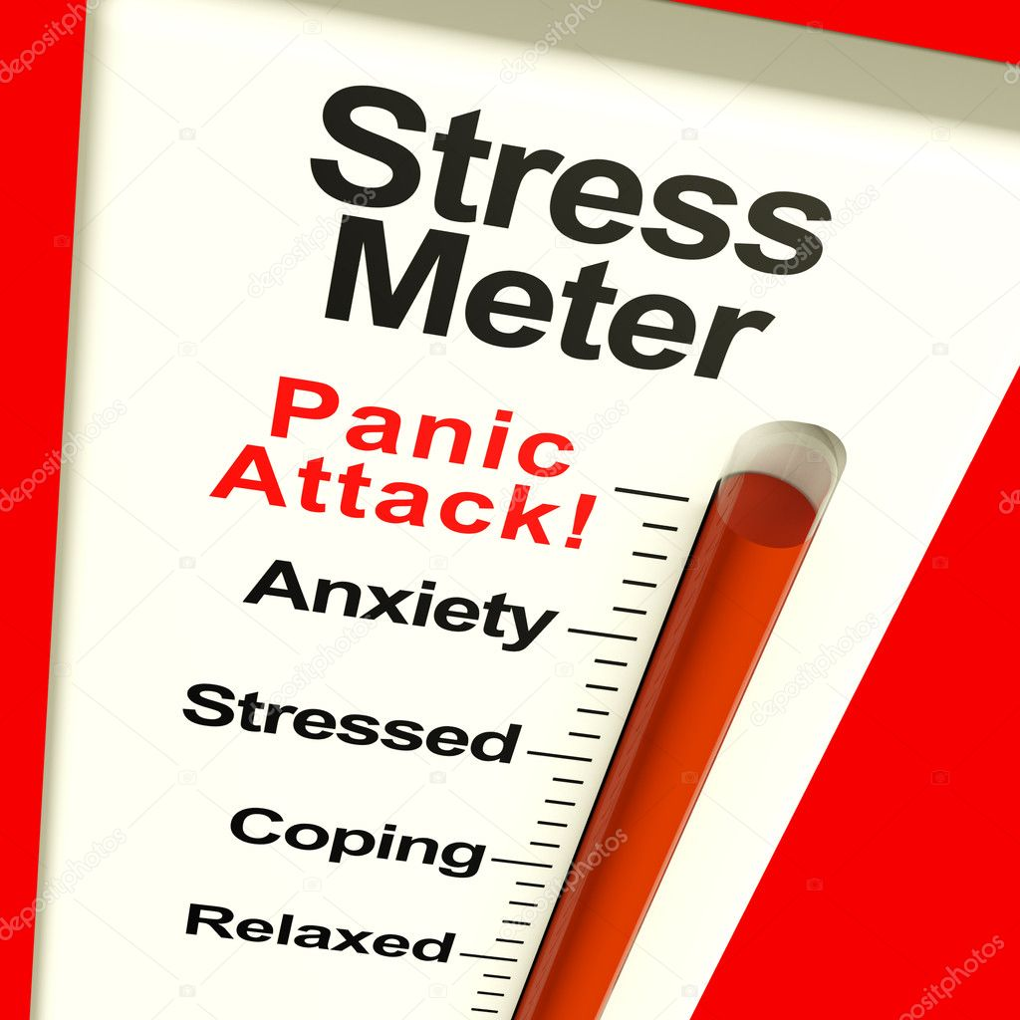
Stress Response
Activation of the stress response affects smooth muscle, fat, the gastrointestinal tract, the kidneys, and many other organs and the body functions that they control.

Slide 7
Stress Response 2
The stress response affects the body's regulation of:
Temperature
Appetite and satiety
Arousal
Vigilance
Attention
Mood
Physical adaptation to stress allows the body to redirect oxygen and nutrients to the stressed body site, where they are needed most.

Slide 8
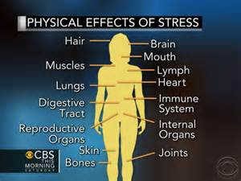
Symptoms of Stress
Stress does not discriminate and can affect any part of the body resulting in physical, mental and emotional symptoms that could include:
Allergies
Dizziness
Headache
Heart palpitations
Environmental sensitivity
Impaired coordination
Impaired immunity
Weight gain.

Slide 9
Weight Gain
Weight gain is often linked to lack of exercise and emotional eating by people who are already under chronic stress.
Researchers have found evidence to suggest that when there are changes in the body, such as elevated cortisol levels that is due to stress, the result could be insulin resistance and weight gain.

Slide 10
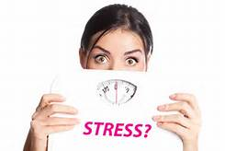
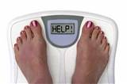
How Cortisol Affect Weight Gain
During Stress the body excretes corticotrophin releasing hormone and adrenalin.
This reaction stimulates the release of Cortisol.
Cortisol stimulates glucose in the blood stream.
Insulin is a fat storage hormone that regulates blood sugar in glucose.
Extreme stress cause excessive release of insulin.
Excess release of insulin sends message to the body to store fat in the abdomen.

Slide 11
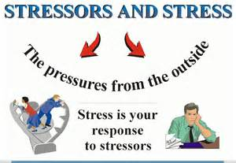
Stress Factors
In general, stress is related to both external and internal factors.

Slide 12
External Factors
External factors include your physical environment which includes the following:
Your job
Your relationships with others
Your home
In addition to all the situations, challenges, difficulties, and expectations you're most likely confronted with frequently.

Slide 13
Internal Factors
The role of the internal factors is to determine your body's ability to respond to, as well as deal with, the external factors that cause stress.
Internal factors which significantly affect your ability to properly handle stress include:
Your nutritional status
Overall health and fitness levels
Emotional well-being,
The amount of sleep and rest you get.

Slide 14
What's Food Got to do with Stress?
Nutritional stress is possibly the most significant type of physical stress for us modern day enlightened individuals.
Compared to past generations, our bodies and organs have a harder time digesting, assimilating and metabolizing what we eat and drink.
Certain foods increase the physical stress on our bodies by making digestion more difficult thus denying the brain of important nutrients.

Slide 15
How is Your Diet?
Do you give your body toxin-loaded, chemically-constituted platefuls of food and expect it to cope without a grumble?
Even if you eat fairly healthy, today’s fast paced lifestyle effectively ensures that people are more likely to gulp down half chewed mouthfuls, putting more strain on their digestive system.
Hence, our current lifestyle creates enormous stress on our bodies.

Slide 16
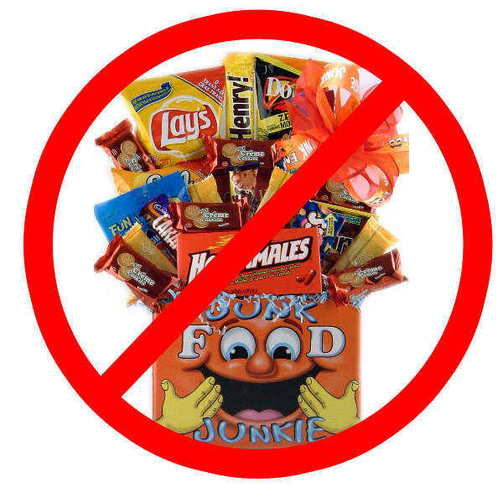
Beware of these Stress Dangers
Caffeine
Sugary foods
Salt
Nicotine
Alcohol
Toxins
Fasting

Slide 17
Caffeine
Relying on caffeine to keep you going throughout the day is not a good idea.
Caffeine stays in the body up to 6 hours before it starts to deplete while continually triggering the release of cortisol.
Caffeine raises stress hormones leading to-
Insomnia
Dehydration
Reduced ability to fight stress

Slide 18
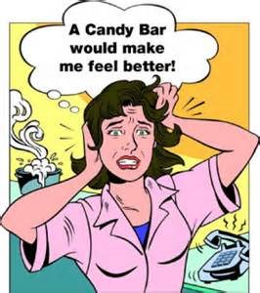
Sugary Foods
While it is true that your body needs glucose to perform at optimum peak, too much sugar is never good.
High sugar foods spike your blood sugar quickly leading to a sharp drop later.
You will feel sluggish, tired and drowsy.
Research shows that the body can only work well with about three teaspoon sugar at a time.
Chocolate contain sugar and caffeine.

Slide 19
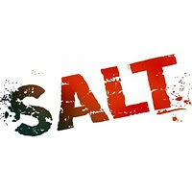
Salt
Salt can dehydrate the body and brain subsequently causing fatigue.
It also increases blood pressure.
When excess salt is consumed it will begin to collect in the blood, and since sodium attracts water, the blood volume increases.
The more blood volume someone has, the harder the heart has to work to keep the blood moving leading to increased pressure in the arteries.

Slide 20
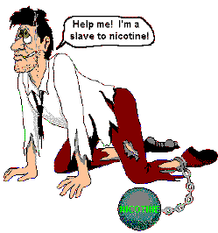
Nicotine
Nicotine's quite unique in that it has a biphasic effect. It is both
a stimulant and a depressant.
In small doses, it binds to acetylcholine receptors, having a stimulating effect. In larger doses, it clogs them up and blocks them, and acts as a depressant.
Smoking causes an increased stress in the whole body even though there seems to be a lessening of stress when the body gets its 'fix' from the nicotine.
Nicotine users frequently have a lower threshold for pain, possibly because smoking stimulates adrenaline and also blocks one of the body's natural pain relievers. Smokers are more vulnerable to headaches.

Slide 21
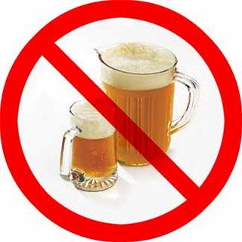
Alcohol
Drinking alcohol produces physiological stress,
Some of the body's responses to alcohol are similar to its responses to other stressors. Yet, individuals also drink to relieve stress.
Drinking alcohol produces effects similar to those they are trying to relieve

Slide 22
Alcohol 2
Some researchers have found that high levels of stress may influence drinking:
When alternative resources are lacking
When alcohol is accessible
When the individual believes that alcohol will help to reduce the stress.

Slide 23
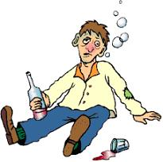
Metabolizing Alcohol
Alcohol isn't metabolized like other foods and drinks.
The amount of energy it takes to metabolize large doses of alcohol causes more stress to the body, even if you feel relaxed.
Alcohol provides no nutrients
Alcohol is a poison when over consumed.

Slide 24
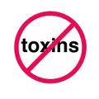
Toxins
Some produce contain possible herbicides, pesticides, and fungicides.
Chemical food additives and preservatives, PCB’s (a group of chemicals known to be carcinogenic)
Limit barbecued or charred food, and avoid smoked or cured meats, a source of nitrosamines.

Slide 25
Toxins 2
Many plastics today contain phthalate, a dangerous toxin.
Limit your use of plastics as much as possible, and do not microwave in plastic containers not designed for such use.
Poisons like mercury collect in fatty tissues, and mercury amounts are highest in large fish.
Avoid covering your food in the microwave with plastic wrap as toxins in the plastic can end up in your food.

Slide 26
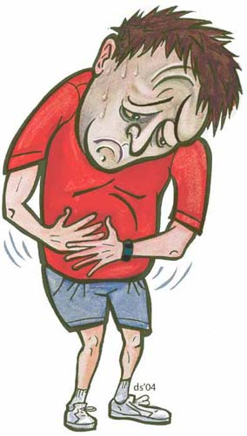
Toxin Damages
Toxins are mostly stored in the fat cells.
Stored toxins can lead to:
Free radical damage
Inflammation associated with obesity and metabolic syndrome
Increased acidity in the body that contributes to additional inflammation
Immune system stress (from constantly reacting to the presence of toxins)
Reduced energy and strain on the heart (from adding extra blood vessels to feed growing toxic fat cells and tissues).
Water retention (from the body retaining fluid to dilute circulating toxins)

Slide 27
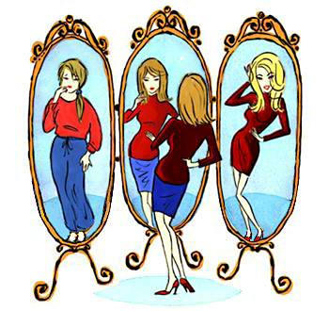
Fasting
Going for more than four hours without eating does the following:
Slows your metabolic rate
Disrupt blood sugar levels
Sets you up for binge eating and sugar cravings

Slide 28
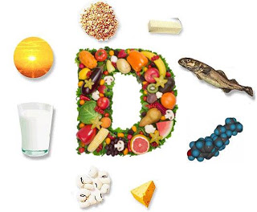
Balanced Diet for Stress Management
Reducing Stress demands a strong nervous system. This means that you must boost your intake of vitamins B, C and E, together with minerals magnesium and zinc.
The best source of these nutrients is from food, rather than supplements.

Slide 29
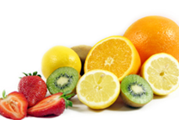
Balanced Diet for Stress Management
It is essential to eat a balanced diet of meat, nuts, seeds, fresh fruit and vegetables and oily fish.
Fresh organic food is the best source. If fresh ones are not available, frozen vegetables are a good alternative.

Slide 30
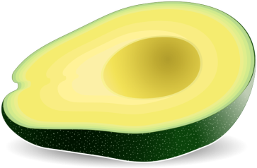
Foods for Stress Management
Avocados
One of the best ways to reduce high blood pressure is to get enough potassium, and half an avocado has more potassium than a medium-sized banana.
A little bit of guacamole, made from avocado, might be a good choice when stress has you craving a high-fat treat. Avocados are high in fat and calories, though, so watch your portion size.

Slide 31
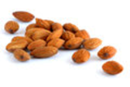
Foods for Stress Management
Almonds
Almonds are chock-full of helpful vitamins: vitamin E to bolster the immune system, plus B vitamins, which may make you more resilient during bouts of stress or depression. To get the benefits, snack on a quarter of a cup every day.
Raw Veggies
Crunchy raw vegetables can help ease stress in a purely mechanical way. Munching celery or carrot sticks helps release a clenched jaw, and that can ward off tension.

Slide 32
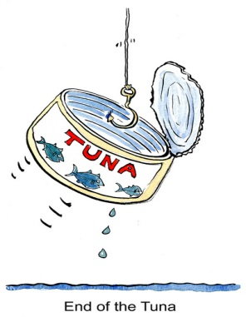
Foods for Stress Management
Tuna
A great lunch option, tuna is high in stress-fighting vitamins B6 and B12.
Tuna is also a good low-fat protein source.
Beef
Beef contains high levels of zinc, iron, and B vitamins, which are also known to help stabilize your mood.

Slide 33
Foods for Stress Management
Asparagus
This green veggie is high in folic acid, which can help stabilize your mood.
Eating certain vitamins and minerals like folic acid and B vitamins can significantly improve your mood because the body uses them to make serotonin, a chemical that directly affects mood in a positive way.

Slide 34
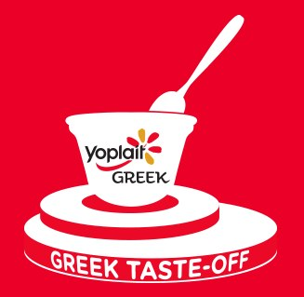
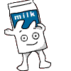
Foods for Stress Management
Bedtime Snack
Carbs at bedtime can speed the release of the brain chemical serotonin and help you sleep better.
Considering that heavy meals before bed can trigger heartburn, it helps to stick to something light.
Milk
Another bedtime stress buster is the time-honored glass of warm milk.
Research shows that calcium eases anxiety and mood swings linked to PMS.
Skim or low-fat milk is better to limit fat intake.

Slide 35
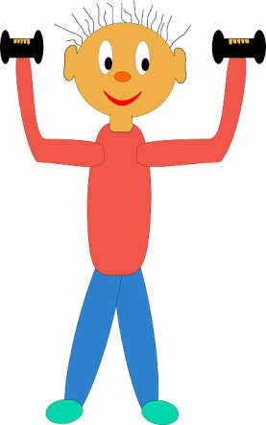
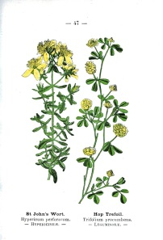
Foods For Stress Management
Herbal Supplements
There are many herbal supplements that claim to fight stress.
One of the best studied is St. John's wort, which has shown benefits for people with mild to moderate depression.
It also appears to reduce symptoms of anxiety and PMS.
Tell your doctor about any supplements you take, so they can check on any possible interactions.

Slide 36
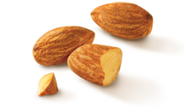
Foods For Stress Management
Nuts and Seeds
Pistachios, as well as other nuts and seeds, are good sources of healthy fats.
Eating a handful of pistachios, walnuts, or almonds, every day may help lower your cholesterol, ease inflammation in your heart's arteries, make diabetes less likely, and protect you against the effects of stress.
Don't overdo it, though: Nuts are rich in calories.
Dried Apricots
Apricots are rich in magnesium, a known stress-fighter and a natural muscle relaxant.

Slide 37
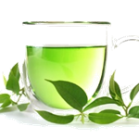
Foods For Stress Management
Tea (Black and Green)
Drinking black and green tea may help you recover from stressful events more quickly.
One study compared people who drank 4 cups of tea daily for 6 weeks with people who drank another beverage.
The tea drinkers reported feeling calmer and had lower levels of the stress hormone cortisol after stressful situations
Having tea after meals can aid in digestion and shut off your appetite.

Slide 38
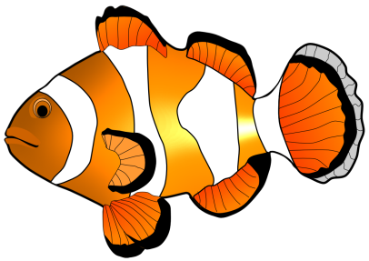
Foods For Stress Management
Fatty Fish
Omega-3 fatty acids, found in fish such as salmon and tuna, can prevent surges in stress hormones and may help protect against heart disease, depression, and premenstrual syndrome (PMS).
For a steady supply of feel-good omega-3s, aim to eat 3 ounces of fatty fish at least twice a week.

Slide 39
Foods for Stress Management
Green Leafy Vegetables
Too little magnesium may trigger headaches and fatigue, compounding the effects of stress.
One cup of spinach helps you stock back up on magnesium.
Other green, leafy vegetables are good magnesium sources like kale, mustard, Swiss chard, collard greens and turnip greens.
Try some cooked soybeans or a fillet of salmon, also high in magnesium.

Slide 40
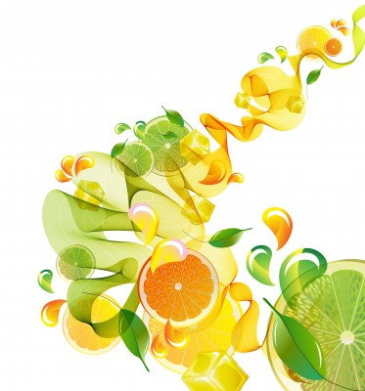
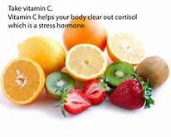
Foods For Stress Management
Vitamin C
Studies show that vitamin C can curb levels of stress hormones while strengthening the immune system.
In one study of people with high blood pressure, blood pressure and levels of cortisol (a stress hormone) returned to normal more quickly when people took vitamin C before a stressful task.

Slide 41
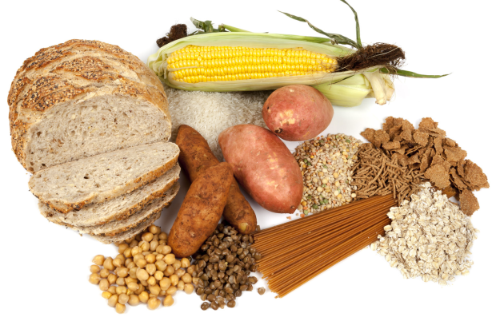
Foods for Stress Management
Complex Carbs
All carbs prompt the brain to make more serotonin.
To get a prolonged supply of this feel-good chemical, eating complex carbs is best because it takes longer to digest.
Good choices include whole-grain breads, pastas, and breakfast cereals, and oatmeal.
Complex carbs can help you feel balanced by stabilizing blood sugar levels.

Slide 42
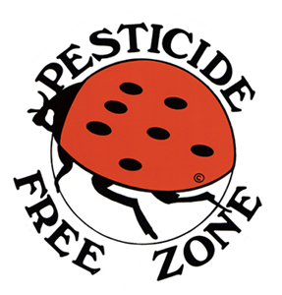
Stress Management
Avoid Aspartame, Saccharin, Splenda, Nutrasweet, & artificial sweeteners in general.
These are excitotoxins that affect your brain chemistry.
Use natural sweeteners like stevia or xylitol.
Check labels and ask at restaurants to avoid MSG- an excitotoxin.

Slide 43
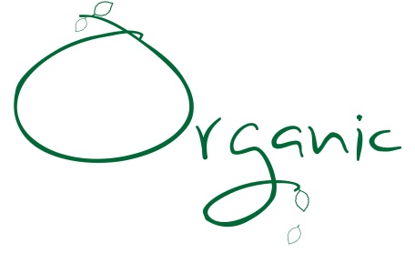
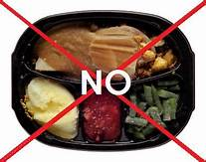
Stress Management 2
Buy organic food to eliminate possible herbicides, pesticides, and fungicides.
Minimize your consumption of processed foods - frozen dinners, canned soups, and pre-packaged snack foods.
Eat smaller fish to reduce the risk of mercury consumption
Do not eat the fatty portions, and follow your local guidelines for limits on safe fish consumption in your area.

Slide 44
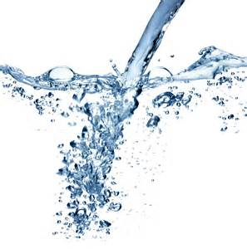
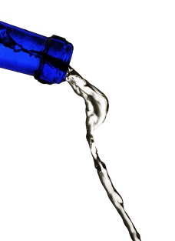
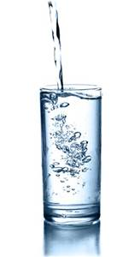
Water
Drink water
If you want to deal with stress, drink water.
Water hydrates every part of the body and brain and helps you to better cope with stressful situations.
A good rule is to take a few sips every 15 minutes.
The best source is room-temperature still water bought in glass bottles (some plastic bottles can leach chemicals into the water inside) or use a jug filter system that you fill from the tap.

Slide 45
Foods That Increase Stress
Foods to Avoid
Coffee and other caffeinated beverages
Substitute black or green tea for coffee; it has less than a third of the caffeine in coffee.
Fried foods and foods rich in fat are very immune-depressing, especially considering that the stress is already doing that.
Reduce animal foods.
High-protein foods elevate brain levels of dopamine and norepinephrine, both of which are associated with higher levels of anxiety and stress.

Slide 46
Don’t Forget to Exercise
Reduce Stress With Good Old Exercise
Besides changing your diet, one of the best stress-busting strategies is to start exercising.
Aerobic exercise boosts oxygen circulation and spurs your body to make feel-good chemicals called endorphins.
Aim for 30 minutes of aerobic exercise three to four times a week.

Slide 47
Remember
The better nourished you are, the better able you are to cope with stress.
It is well known that changes take place in the levels of circulating hormones when stress occurs.
Some researchers have stated that almost any form of stress may influence nutritional balance.
This is because stress causes a general arousal that increases the body's metabolism, or the rate at which the body changes food supplies into energy.

Slide 48
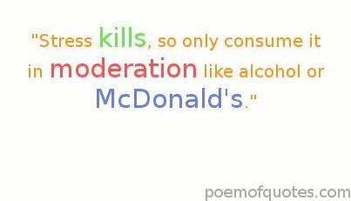
Final Thoughts
Eating right is just as important as managing stress because vulnerability to stress increases with poor diet.

Slide 49
Questions

Slide 50
References
Read more: http://healthmad.com/health/the-effects-of-sodium-on-the-human-body/#ixzz3niosNsQ0
(5) Meany, M.J.; Diorio, J.; O'Donnell, D.; Smythe, J.W.; Parent, A.; & Sharma, S. Serotonin as a mediator of the effects of environmental events on the development of the hypothalamic-pituitary-adrenal axis. In: Hunt, W., & Zakhari, S., eds. Stress, Gender, and Alcohol-Seeking Behavior. National Institute of Alcohol Abuse and Alcoholism Research Monograph No 29. Bethesda, MD: the Institute, 1995.
Tsigos, C., & Chrousos, G.P. The neuroendocrinology of the stress response. In: Hunt, W., & Zakhari, S., eds. Stress, Gender, and Alcohol-Seeking Behavior. National Institute on Alcohol Abuse and Alcoholism Research Monograph No. 29. Bethesda, MD: the Institute, 1995.
Foods That Help Tame Stress. http://www.webmd.com/diet/ss/slideshow-diet-for-stress-management

